Slide 1
MapReduce – Processing Data
Pravin Y Pawar

Slide 2
MapReduce
Programming Paradigm
Helps in processing massive amounts of data in parallel
Consists of two phases : Map and Reduce
High Level Working
Input data is spitted into blocks / chunks
Map tasks process these independent chunks completely in parallel manner
Output produced by Map task are stored on local disk of the node
Output of the Map tasks are automatically shuffled and sorted by the framework
These intermediate outputs are sorted by keys
Reduce tasks provides reduced output by combining the output of various mappers
Job inputs and outputs are stored on the file system

Slide 3
MapReduce Framework
MapReduce Framework
Phases :
Map : Converts into key value pair
Reduce : Combines output of mappers and produces a reduced result set
Daemons :
JobTracker : Master, schedules task
TaskTracker : Slave, executes task

Slide 4
Daemons
HDFS and MapReduce f/w works on same node
Principle of data locality is leveraged
Results into high throughput
Two Daemons :
JobTracker
Single per cluster
Responsible for scheduling tasks to TaskTrackers, monitoring and re-executing the task if failed
TaskTracker
One slave TaskTracker per cluster node
Actually executes the task

Slide 5
JobTracker
Master daemon responsible for overall MapReduce job
Single JobTracker per cluster
Provides connectivity between Hadoop and application
Application (client code) is submitted to cluster
JobTracker creates execution plan by deciding which task to assign to which node
Monitors all the running tasks
If the task fails, it automatically re-schedules task to different node after number of retries

Slide 6
TaskTracker
Responsible for executing individual tasks that is given by JobTracker
Single TaskTracker per slave
Spawns multiple JVMs to handle multiple map and reduce tasks in parallel
Send heartbeat messages regularly to JobTracker
If JobTracker does not received the message, assumes that TaskTracker has failed and reschedules that task on another node

Slide 7
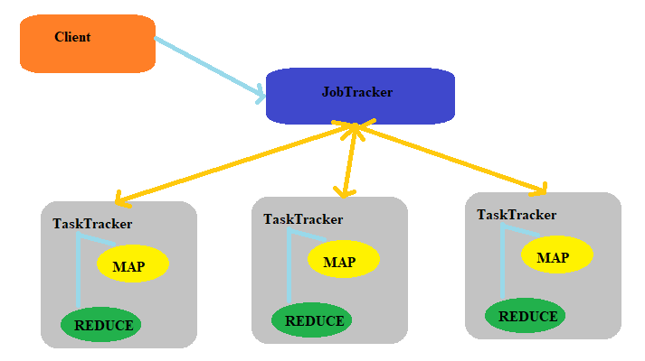
JobTracker and TaskTracker Interaction

Slide 8
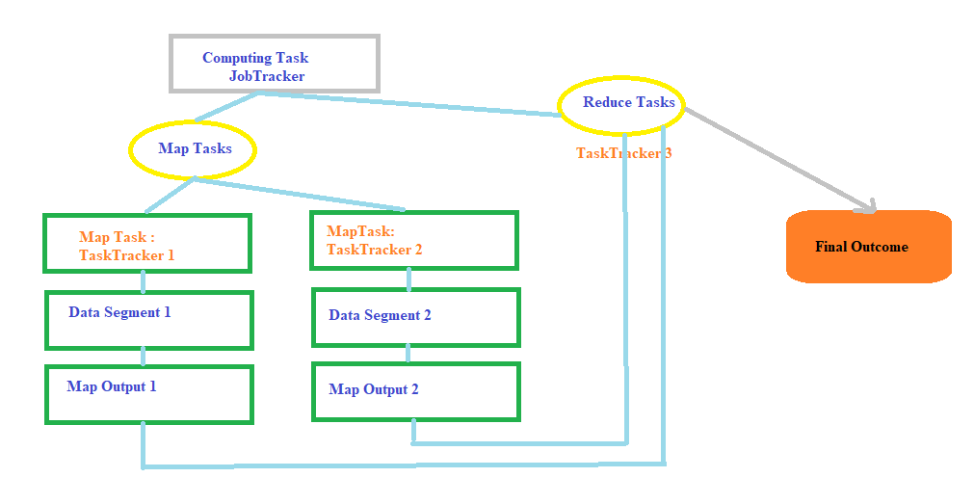
MapReduce WorkFlow

Slide 9
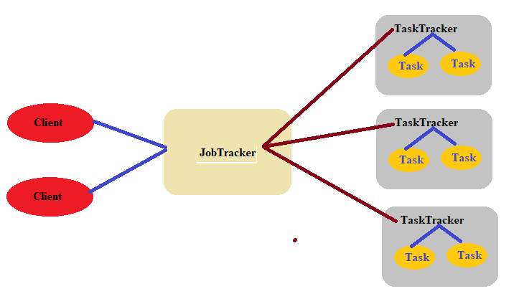
MapReduce Programming Architecture

Slide 10
MapReduce Programming Architecture (2)
Input dataset is split into multiple pieces of data (several small sets)
Framework creates a master and several worker processes and executes the worker processes remotely
Several Map tasks work simultaneously and read pieces of data that were assigned to each map. Map worker uses the map function to extract only those data that are present on their server and generates key/value pair for the extracted data.
Map worker uses partitioner function to divide the data into regions. Partitioner decides which reducer should get the output of specified mapper.
When the map workers complete their work, the master instructs the reduce workers to begin their work.
The reduce workers in turn contact the map workers to get the key/value data for their partition. The data thus received is shuffled and sorted as per keys.
Then it calls reduce function on every unique key. This function writes output to the file.
When all the reduce workers complete their work, the master transfers the control to the user program.

Slide 11
Thank You!
Reference :
Big Data and Analytics by Acharya, Chellappan
In our next session: YARN

